Slide 1
How ChatGPT Affects the Email Writing Skills of Students
By-
Sourav Roul (102115165)
Dhruv Singh (102115246)
Harshit Sharma (102115249)
Submitted to
Ms. Rishita Goyal
Unleashing the Pen or Crippling the Craft?

Slide 2


1
What is ChatGPT?
Introduction
2
How is it Useful?
Adaptation of ChatGPT in Email Writing.
3

Slide 3
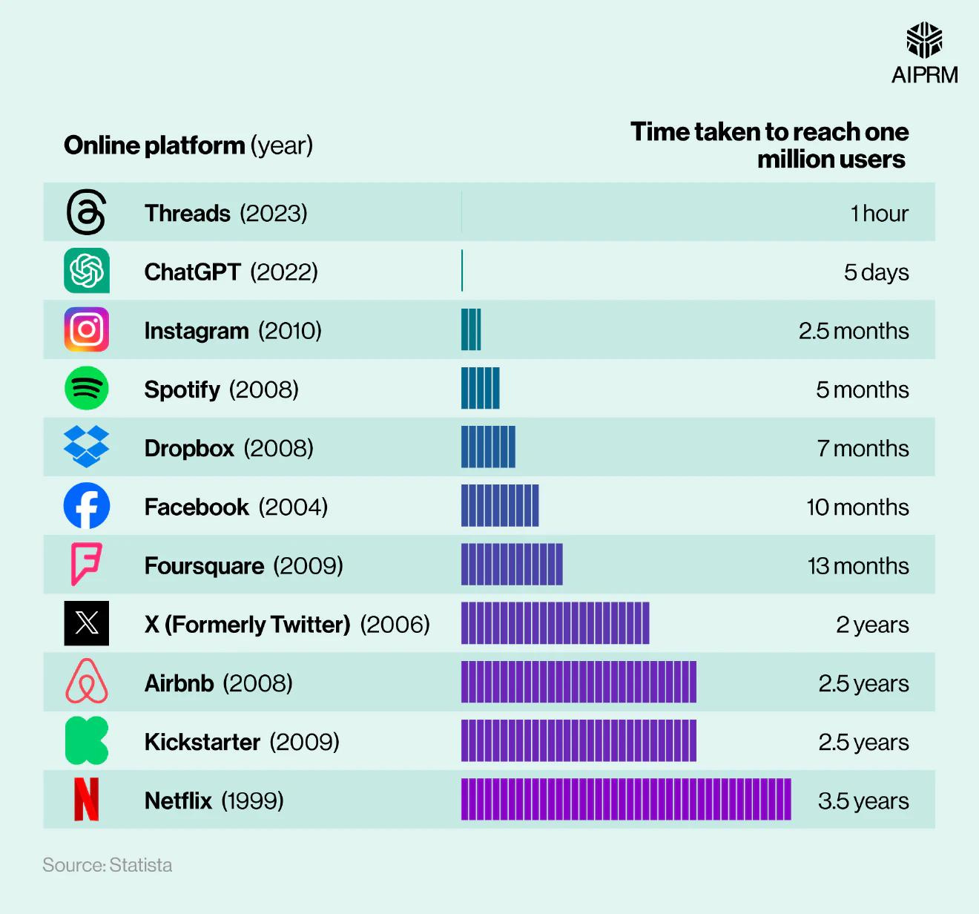
Time Taken to Reach 1 Million Users!

Slide 4
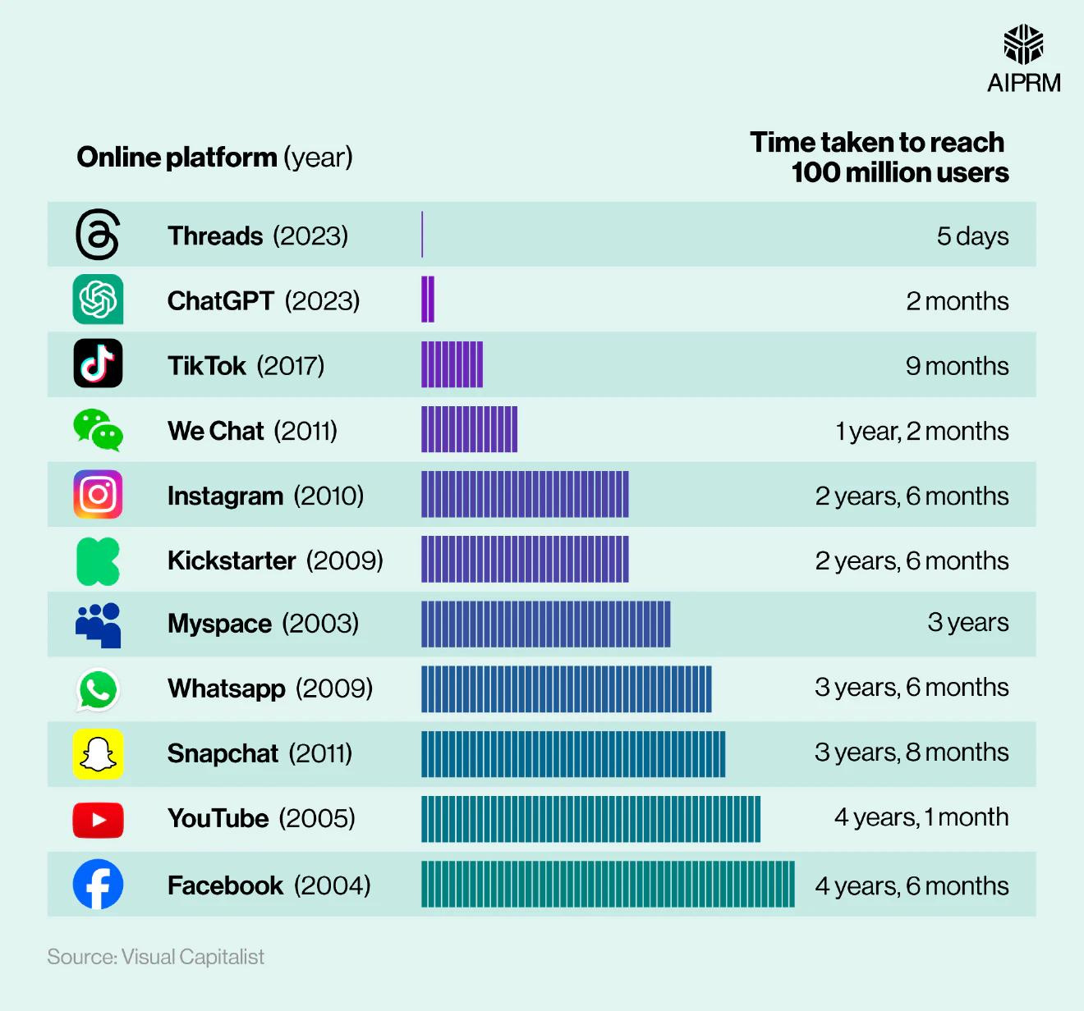
Time Taken to Reach 100 Million Users!

Slide 5
Framework
Assess the frequency of ChatGPT usage for email writing among students
Evaluate the impact on human touch, creativity, and originality
Analyze changes in email etiquette, tone, and language conventions
Determine the effect on time spent composing emails
Gauge improvements or challenges in overall email writing skills

Slide 6

Objective
Understand the extent of ChatGPT's influence on students' email writing
Identify potential benefits and drawbacks of using ChatGPT for email composition
Explore the implications for writing skills development and adaptation

Slide 7
Study Design
Quantitative research approach
Cross-sectional survey method
Target Population
College students
Enrolled in various academic programs
Diverse backgrounds and age groups
Data Collection Instrument
Google Forms survey
15 questions (mix of multiple-choice, rating scales, and open-ended)
Research Methodology

Slide 8

Survey Structure
Demographic information (student status)
Frequency of ChatGPT usage for email writing
Impact on writing skills, human touch and creativity
Changes in email etiquette, tone, and language
Time savings and overall writing skills improvement
Confidence levels before and after using ChatGPT
Data Analysis
239 responses collected
Quantitative analysis of multiple-choice and rating scale responses
Descriptive statistics (frequencies, percentages)
Thematic analysis of open-ended responses

Slide 9

Result: ChatGPT Usage and Impact
Noticeable shifts in tone and language, both formal and informal
Majority of students use ChatGPT occasionally or rarely for email writing
Mixed opinions on the impact on human touch and creativity

Slide 10
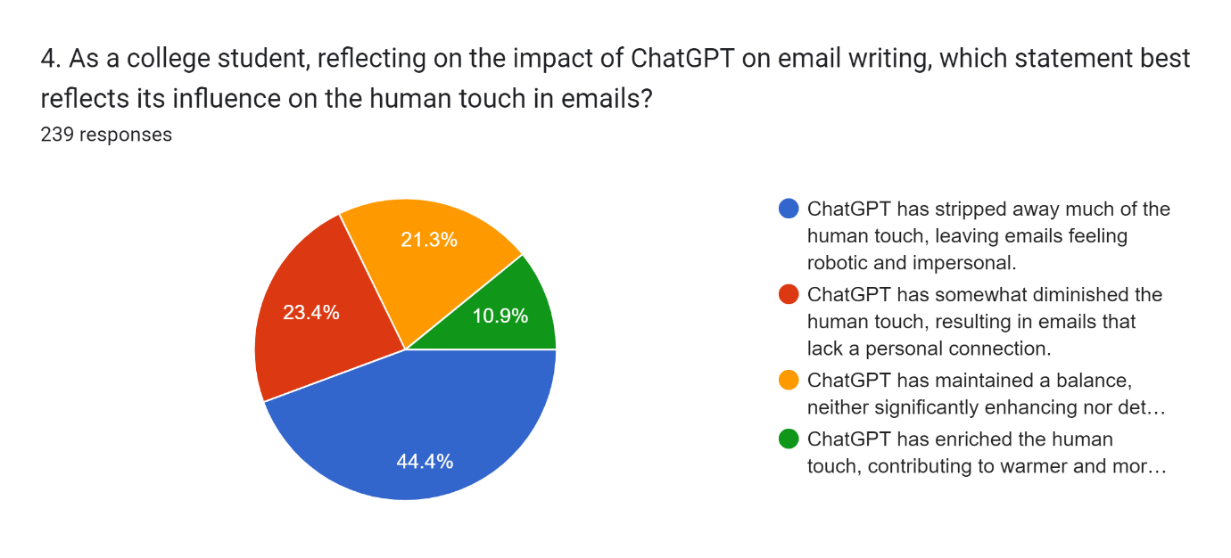
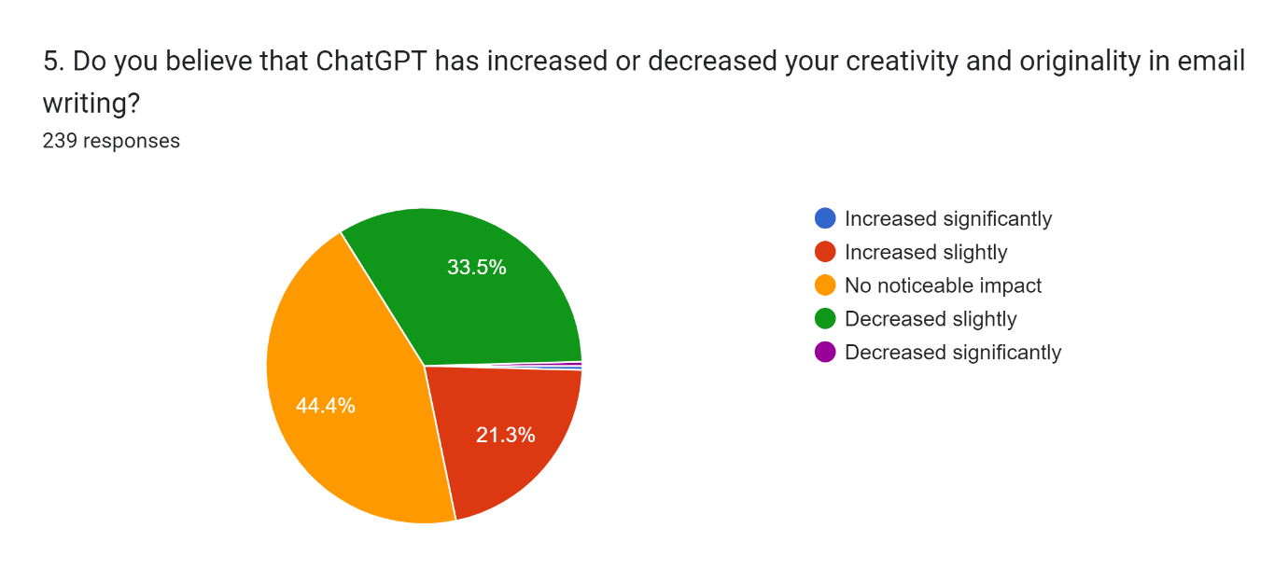
Visualization
I

Slide 11
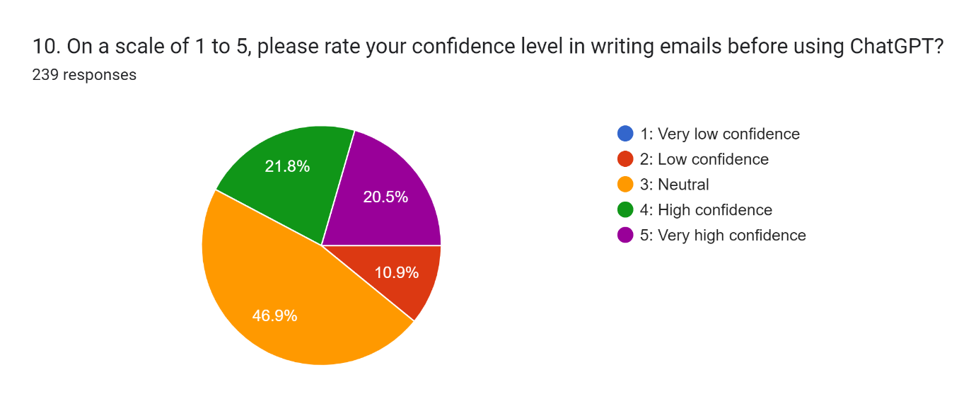
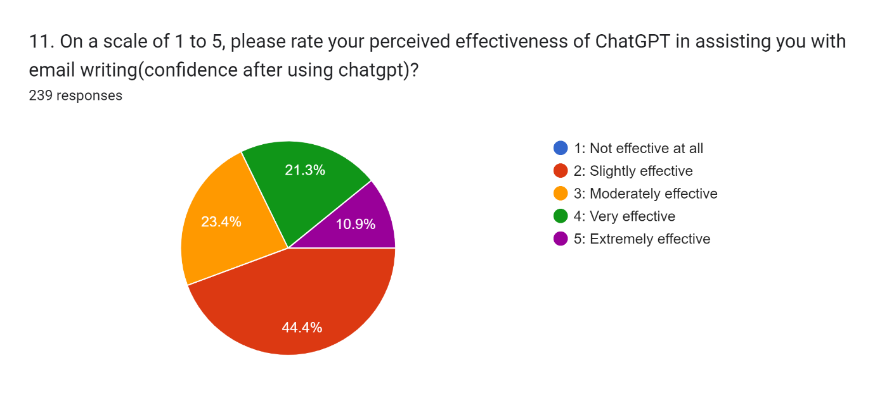
Visualization
II

Slide 12
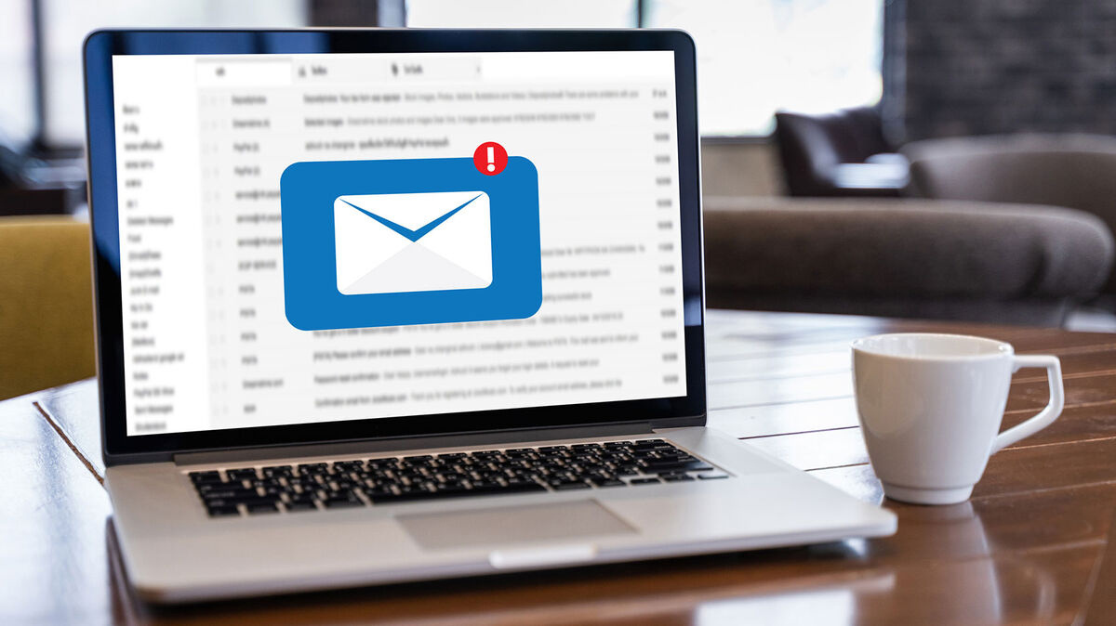
Results: Email Etiquette and Time Savings
Some experienced negative consequences in email communication
Improved understanding of email etiquette for some, worsened for others
Significant time savings reported by many students

Slide 13

Results: Writing Skills and Feedback
Varying levels of confidence before and after using ChatGPT
Improvements in writing skills observed by some, no change for others
Positive feedback received from professors/recipients by some

Slide 14

Conclusion
1
2
3
Summarize key findings
Highlight the potential benefits and drawbacks of using ChatGPT for email writing
Emphasize the importance of maintaining a balance between technology and human skills
4
Encourage responsible and ethical use of AI writing tools

Slide 15
THANK YOU FOR ATTENDING!
Feel free to ask any
kind questions or clarifications!

